Slide 1
Computer Architecture Concepts
Part 22 – RISC-V Output string to console

Slide 2
Objectives
Look at how a string can be stored in memory and given a label so that it can be used in a program
Look at the information to set up to print a string to the console

Slide 3
Strings of characters
We can print a single character to the console
We store the ASCII value for the character in register a0
A string is a sequence of characters
Cannot store whole string in a single register
We must store strings in memory
We can store a memory address in a register
Need a way to specify strings in program so that they will be put in memory when the program is assembled
Need to be able to specify the memory address that goes with a specific string
We give each string a label

Slide 4
RISC-V Assembler Directives
The memory you want to use in the data segment
.data
The program instructions
.text
The types of data you want to store
.asciz or .string
Store a string in the data segment and add null terminator

Slide 5
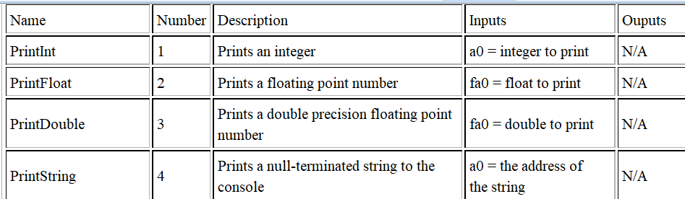
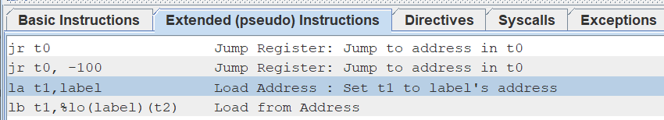
ecall to output a string
To output a string
Put 4 in a7
Put the address of the string to print in a0
Need to load address
Use a label for the string
la from the pseudo instructions

Slide 6
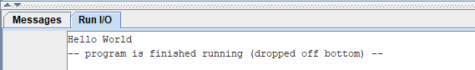
Example
The message to store
in memory – in double quotes
.data
message: .string "Hello World"
.text
la a0, message
addi a7, zero, 4
ecall
This is a label as an alias for the memory address where the string is stored.
Load the address corresponding to the label message into a7

Slide 7
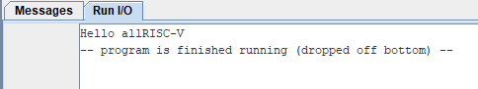
Example with more strings
.data
message: .string "Hello all"
message2: .string "RISC-V"
.text
la a0, message
addi a7, zero, 4
ecall
la a0, message2
ecall
Notes:
This is from part22

Slide 8
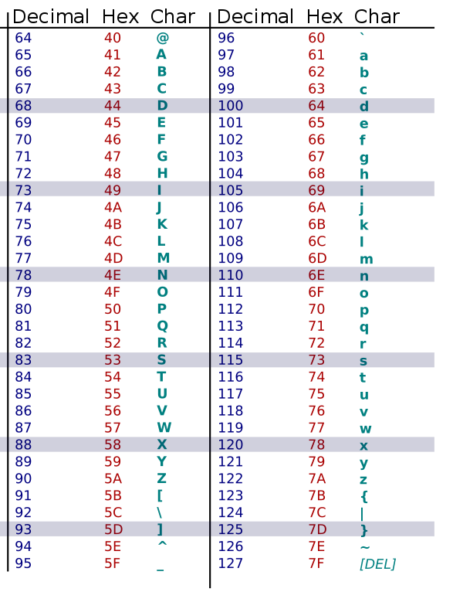

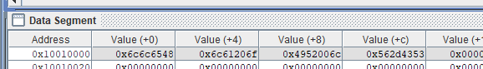
Looking at the data in the data segment
.data
message: .string "Hello all"
message2: .string "RISC-V"
RISC-V is little-endian
The order of the data within each word is to have the lowest order byte first

Slide 9
Summary
Strings have to be stored in memory
We use the .data part of the program with a label
To output a string to the console
We load the address of the string to a0
We set a7 to 4
We do ecall

